Slide 1
Follow us on Social Media
@utahtechcareerservices

Slide 2
Hitting the Bullseye
A Freshman’s Guide to Career Success at Utah Tech University

Slide 3
Agenda
Aiming for Success with Career Services
Hitting the Mark with Handshake
Bullseye Resumes with Hiration
Perfecting your Aim: Career Coaching
On-Target Q&A

Slide 4
Aiming for Success with Career Services

Slide 6
Services We Offer
Major Exploration
Career Exploration
Career Assessments
Resumes/CV's
Cover Letters
Internships
Mock Interviews
Career Fairs
Job Searches
Graduate School Search/Applications
Networking Opportunities
Career Closet
Virtual Interview Rooms
"College Student to Career Professional"
Notes:
Group discussion
There is not one right choice.
You may not have one right career or one right major.

Slide 7
Hitting the Mark with Handshake

Slide 8
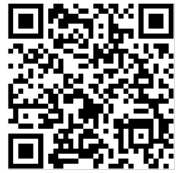
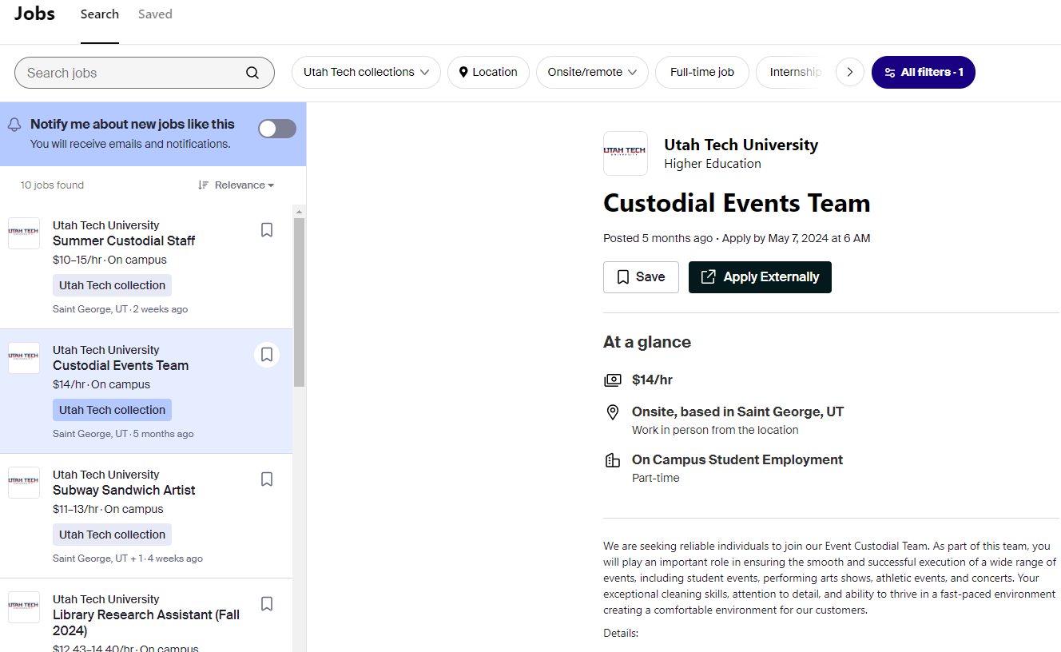
Do you Need a Job?
Local jobs and the only place On-Campus jobs are posted
Utahtech.joinhandshake.com
Handshake App
Handshake Demo

Slide 9
Bullseye Resumes with Hiration

Slide 10
Need help creating a resume?
Resume Builder & AI Reviewer
Cover Letter Creation
LinkedIn Profile Optimizer
Interview Practice with AI Reviewer
Hiration Demo
Go to utahtech.Hiration.com

Slide 11
Perfecting Your Aim with Career Coaching

Slide 12
Who is my Career Coach?
Dottie Catlin
Executive Director
Cheryl Brandt
Employment Specialist
Shane Blocker
Assistant Director & College of Health Sciences
Leann Weibert
College of Science, Engineering, and Technology
Brianna Iverson
College of Education & General Studies
Asha Stapley
College of Humanities & Social Sciences & Arts
Chelsea Buck
College of Business

Slide 13
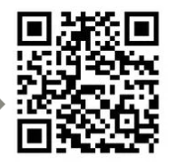
How Do I Find my career coach?
Navigate App | My Team
Schedule Appointments
Navigate Website
5th Floor of the Holland Building

Slide 14
Helpful Resources!
career.utahtech.edu
-Students… Get Started

Slide 15
Thank You! Please complete this survey about our session.
Questions?

Slide 16
Follow us on Social Media
@utahtechcareerservices

