Slide 1
UTAH TECH LIBRARY AND LEARNING SERVICES
Notes:
Introduce ourselves as coordinators of APC and WC

Slide 2
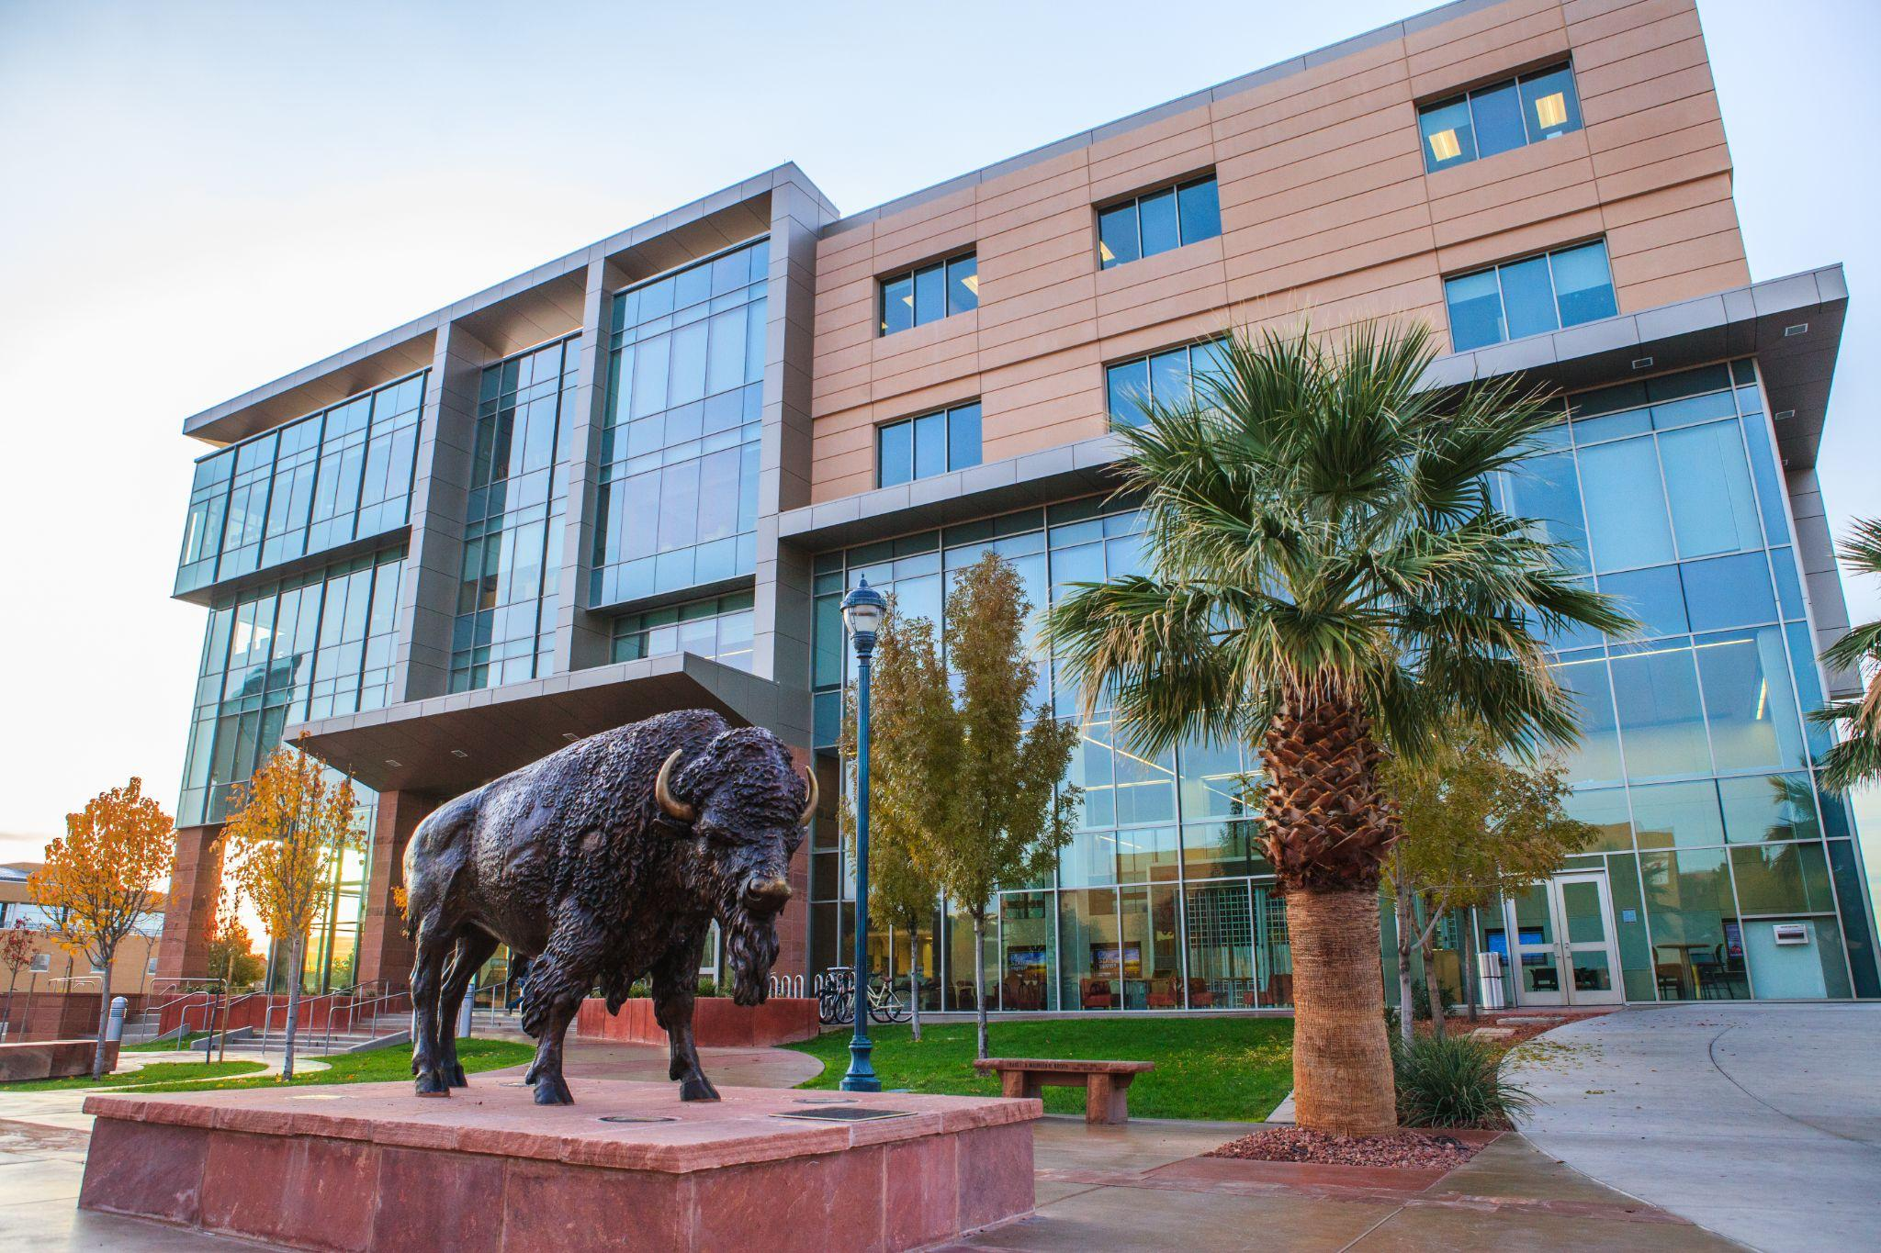
WHAT DO WE OFFER
WRITING CENTER
ACADEMIC PERFORMANCE CENTER
Student’s first stop for help with anything writing related.
Student’s first stop for study hall and tutoring outside of math and english classes.
Notes:
ABBY - Learning services offers multiple resources including the WC and APC. WC helps students with everything writing related, APC helps students with all subjects other than math and english

Slide 3
The ultimate goal of the Writing Center is to aid in the development and creation of strong writers.
The Writing Center is not a place where students can go to get their paper corrected. We provide feedback and a constructive environment where students and tutors can work together to discuss problems and ways to improve.
The Writing Center provides general writing tutoring and departmental writing tutoring.
APA — American Psychological Association
MLA — Modern Language Association
AP — Associated Press
Chicago — Chicago Manual of Style
Departmental writing tutors must prove proficiency in their chosen style of writing.
Notes:
TILLY

Slide 4
Writing Center tutors help students become aware of resources and know how to use them.
Library Research Assistants
Peer tutors who specialize in helping students find research for papers. Located on second floor of HCC.
Library Databases
Purdue Owl – Online resources
Big picture items before smaller issues.
Flow, cohesion, organization, clear ideas → grammar, formatting, citations.
Students can express areas of concern to focus on.
Tutors can help with more than drafts for ENGL classes – resumes, cover letters, lab reports, brainstorming, outlines, scholarship essays, grad school essays, ect.
Notes:
TILLY

Slide 5
Tutoring in a wide variety of subjects
ACC, BIOL, CHEM, PHYS, PSY, BUIS, MKTG, SPAN, CHIN, HIST, XSCI, ECON, ect.
Low division – high demand.
Walk ins are welcome but appointments are recommended
Study Hall – Fulfills study time requirements for athletes and SSC students, open to all students at Utah Tech.
Quiet study area filled with multi-subject tutors
Computers, study rooms, desks with charging stations, comfy chairs, whiteboards.
Notes:
ABBY. You can see some examples right here but the list goes on .I. We tutor most of the 1010s and entry level classes along with upper division classes that students request tutoring on.

Slide 6
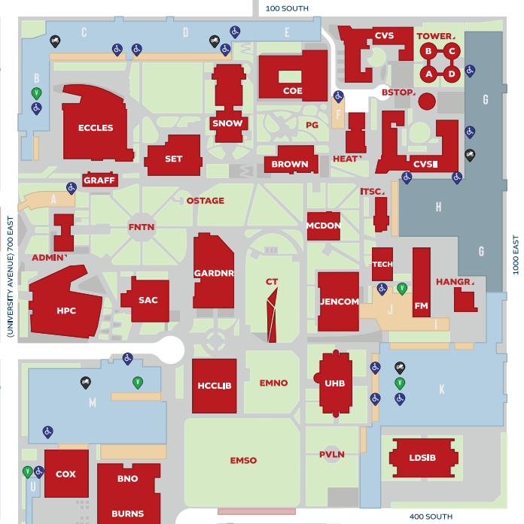
TUTORING IN MULTIPLE LOCATIONS
The Writing Center and Academic Performance Center provide tutoring at multiple different locations across campus.
HOLLAND CENTENNIAL COMMONS
Writing Center – HCC 421
Academic Performance Center – HCC 431
BROWNING
Throughout the week, the APC and Writing Center have tutors in the Student Success Center on the first floor of the Browning.
HAZY
The APC provides business tutoring located on the first floor in the Hazy.
SCIENCE ENGINEERING AND TECHNOLOGY
The APC provides science tutoring on multiple floors of the SET Building.
Notes:
ABBY. BROWNING - General tutor who tutors all subjects and low division classes

Slide 7
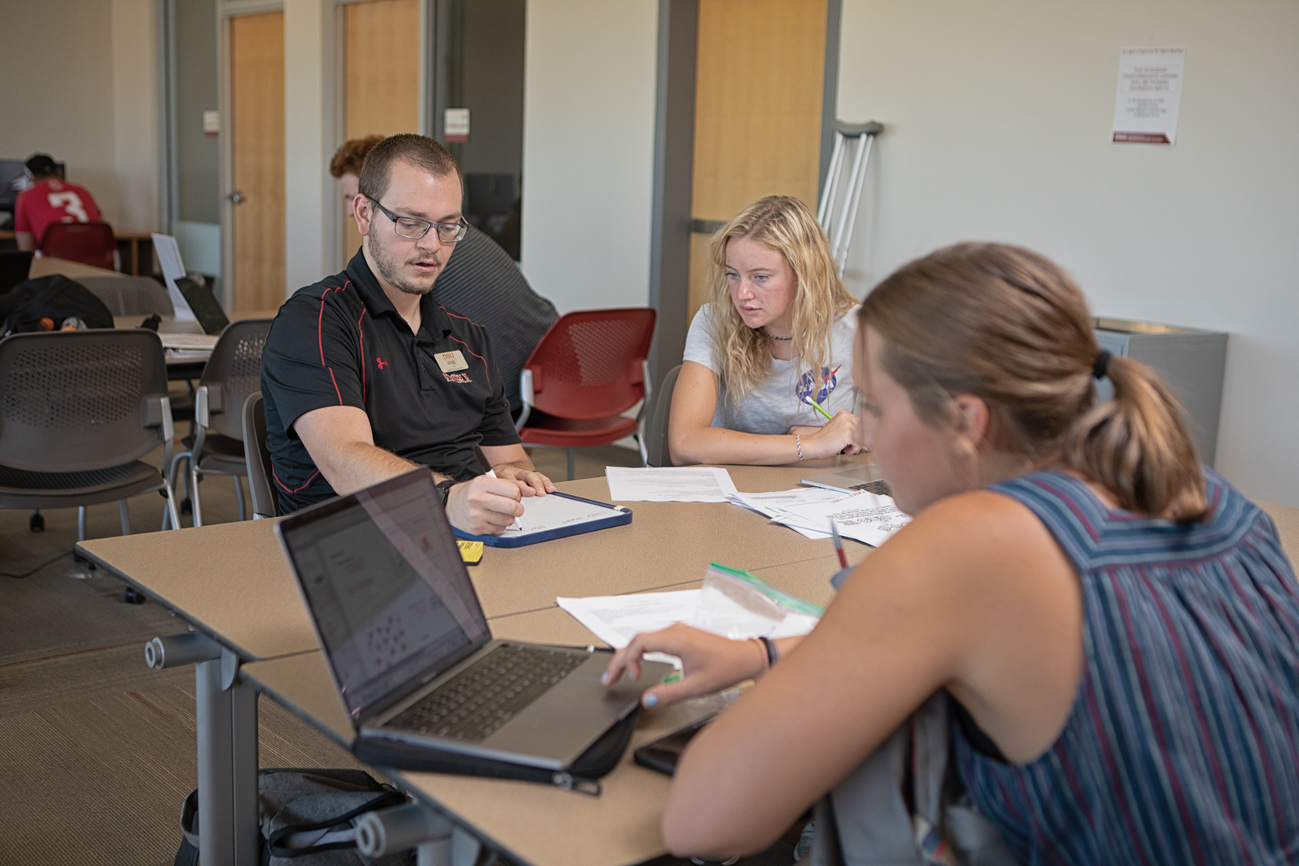
Studies have shown that regular Utah Tech tutoring appointments can improve course results by a whole letter grade
Notes:
ABBY Brining your GPA from a 3.0 to 4.0 with regular tutoring for each course

Slide 8
ITTPC Certified
LIfe Long Skills
OUR TUTORS
Reliable Tutors
In-person & Online
Our peer tutors are CRLA ITTPC certified to provide course work instruction to students of all backgrounds
Help to teach students effective learning methods and study habits
All peer tutors are required to have a minimum of a 3.5 GPA and have received an A in the course they are tutoring
Our tutors offer both face to face and online tutoring sessions for all subjects
Notes:
ABBY All of our tutors are ITTPC certified through CRLA to provide course work instruction… III Our tutors help to teach lifelong skills like… III and they offer both in person and online appointments for all subjects

Slide 9
WHAT HAPPENS IN AN APPOINTMENT
INSTRUCTION
EXAMPLES
STUDENT LED
Tutors help to explain the concepts that students need help understanding.
Students are leading the appointment, explaining concepts to/practicing with the tutor.
Tutors run through example problems with students so they can see concepts in action.
Notes:
ABBY

Slide 10
THINGS TO KNOW
30 MINUTES
SCHEDULE
FREE
APPOINTMENT TYPE
Tutoring appointments are thirty minutes long and are nonconsecutive. This is for the benefit of student and tutor
High demand tutors can book out very quickly, especially around due dates. Schedule in advance.
Utah Tech provides these services at no extra cost to the student.
A scheduled appointment will guarantee your time with a tutor, but both centers will take walk ins.
Notes:
TILLY

Slide 11
THINGS TO KNOW
RESOURCES
GOALS
DIVERSITY
NO BIAS
Students should come prepared with computers/papers to work from, but both centers have computers available for student use.
Meeting regularly with tutors will help students manage their coursework and set/achieve goals.
Diverse tutors for a diverse student population. Tutors come from different backgrounds with different learning styles. Students benefit from this.
Tutors are non discriminatory and show no bias towards students. Tutors display behaviors to motivate students to keep coming back
Notes:
TILLY

Slide 12
HOW TO MAKE AN APPOINTMENT
1
2
3
Use the Navigate app or use Navigate on a web browser. Sign in with Utah Tech Credentials.
Writing Center and APC fall under “Tutoring and Writing Help” as the type of appointment.
Select service – correlates with the classes students are taking. Find date and time that works.
Call either center and the receptionist can help make an appointment.
Notes:
ABBY Making an appointment is super easy, all you have to do is log into the navigate app and… III next you will click the button that says“make an appointment”, then select “Tut… III and finally you will select a service, this correlates to the classes that a student is taking. The student will find a date, time, and tutor that works for them, then schedule the appointment. III and if all else fails you can call the receptionist on duty to schedule an appointment.

Slide 13
WHAT DO WE OFFER
SUPPLEMENTAL INSTRUCTION
OPEN EDUCATIONAL RESOURCES
Peer tutors embedded into a course … The benefits are endless!
The Library is working to alleviate financial burdens for students by helping faculty replace pricey textbooks with free materials.
Notes:
TILLY

Slide 14
Supplemental Instruction
Normal course + added resources = Supplemental Instruction Course
Students must attends regular lecture times and a once-a-week, collaborative study session led by a peer SI Leader. In these SI sessions, students spend extra time with the course content by interacting with it and their peers in fun and informative ways.
SI Leaders are available for tutoring 2 hours a week in the APC.
SI Leaders are students who have previously navigated the course and gotten an A, maintain a high GPA, go through a nationally recognized training program, and be recommended by a professor.
Notes:
TILLY

Slide 15
WHY SI?
Because it works!
In 2022, 80 students were asked how they felt about Supplemental Instruction. 91% of those students reported that they felt that SI was beneficial or very beneficial!
In a similar study conducted in 2023, the students in an SI ENGL-1010 had a 0% fail rate. Those same students in their other classes had a collective 12.5% fail rate.
Notes:
TILLY

Slide 16
Open Educational Resources
An OER is media in any form that has an open license, which professors gather together to use in place of a traditional student-bought textbooks. This may look like research articles, youtube videos, materials the professor has written themselves, interactive content, and anything else that helps the professor share information with the students.
Notes:
TILLY

Slide 17
QUESTIONS?

